Slide 1
Model of Coordinated Action
Notes:
See this as motivation?

Slide 2
Reference
See paper by Charlotte Lee on GitHub on this new model! (presented at CSCW 2015)

Slide 3
“…we do not want to restrict the scope of CSCW to those special settings where the responsibility of accomplishing a task has been allocated to or assumed by a relatively closed and stable collective. The concepts of 'group' and 'group work', however, invariably connote special types of cooperative relations characterized by shared responsibilities. This conceptualization of CSCW will tend to ignore or even dismiss the major challenges posed by the design of systems that support cooperative work arrangements that are characterized by a large and maybe indeterminate number of participants, incommensurate conceptualizations, incompatible strategies, conflicting goals and motives, etc.”
(p.17, Schmidt and Bannon)
Notes:
Schmidt and Bannon [46] had already pointed to the need to
expand the scope of research to settings that are unstable,
large, open, and diverse. They state:

Slide 4
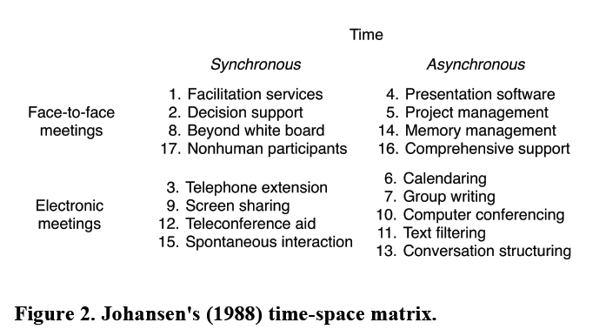
Notes:
Very limited…
Restricted to meetings
And also what about mixed or unsychonrized work?
As well as factors such as predictable versus unpredictable work…

Slide 5
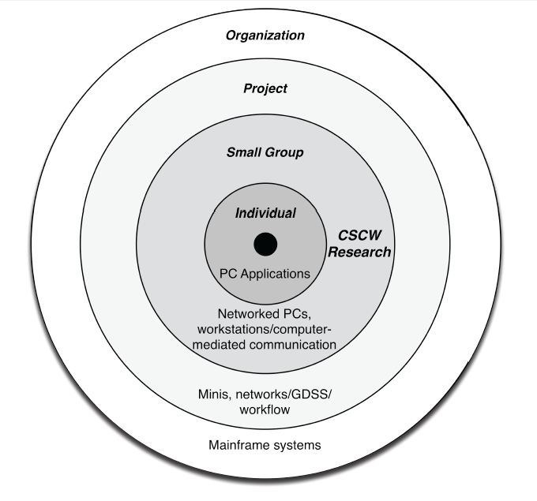
Grudin’s 1994 model for the design space of CSCW
Notes:
Figure 1. A recreation of Grudin's (1994) model for the design
space of CSCW with the technological systems and associated
principal customers or users in each ring. For simplicity we do
not list the software development and research areas included
on the original, although we do note the indication of CSCW
research on the Small Group ring.

Slide 6
Strauss’ Work spectra
Routine versus non-routine
Simple versus complex
New versus established tasks
Small group versus complex assemblages
High turnover versus low turnover members
Expected versus unexpected work

Slide 7
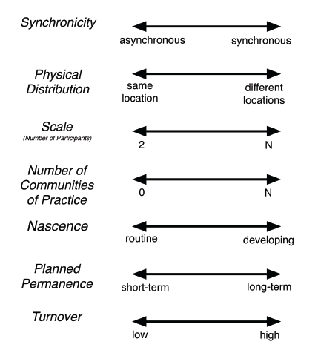
Model of Coordination Action: 7 Dimensions
Notes:
Figure 3. The Model of Coordinated Action (MoCA) and its
seven dimensions with the end points of each continuum.
Scale matters: Coordination theory tells us that when “multiple
actors pursue goals together, they have to do things to
organize themselves that a single actor pursuing the same
goals would not have to do ” [34, p. 5].
In terms of Turnover – examples of a community or population to document a natural disaster falls under that premise.

Slide 8
Nascence and Permanence
A project may be long term but temporary
Importance of:
Boundary negotiating artifacts and jargon during developing work versus
Established boundary objects (e.g., classifications, standards)

Slide 9
Case studies
See the paper for two case studies for demonstration of the framework
Note that is descriptive rather than prescriptive… (just as other models are)
(we will see another model later that is used for evaluation)
But for now let’s look at CSCW technologies!

